Slide 1


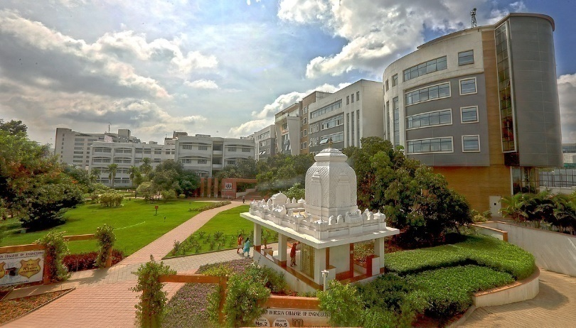
ACCIDENT DETECTION AND REPORTING SYSTEM
KAMALESH BADOLA 1NH20EE048
KUSHAL NAIK K 1NH20EE056
LAVA KUMAR M N 1NH20EE057
MOHAMMED AMAN 1NH21EE407
19EEL49
Date of Presentation: 12.08.2022
Guided By
Mr. SUNIL S K
Designation
Department of Electrical & Electronics Engineering
Bengaluru 560103, Karnataka, India

Slide 2
Introduction
The Accident Detection and Alert System using Arduino is very sufficient and worthy to be implemented in the vehicle, especially in developing countries like Nepal, India, Bangladesh, etc.
The accident is increasing due to the increase in the number of vehicles, as a result, every year the number of death is increasing.
The Accident Detection and Alert System using Arduino prevent uncertain death after an accident because this system sends the message alert to the hospital or police station.
The message alert includes longitude, and latitude (location of accident), in the form of a google map link.

Slide 3
Objective
The aim of the project is to design and develop an accident detection and reporting system .
2

Slide 4
Literature Survey
Table.1
Title of the paper | Author & Year of Publication | Source & Year of Publication | Outcome of the paper
"Integrated Vehicle Accident Detection and Location System” “A Public Safety Application of GPS-Enabled Smart Phones And The Android Operating System” "Intelligent Accident-Detection And Ambulance- Rescue System", | M. Amin, M. Bin IbneReaz and S. Sheikh Nasir, J. Whipple, W. Arensman and M.S Boler B. Prachi, D. Kasturi and C. Priyanka, | TELKOMNIKA (Telecommunication Computing Electronics and Control), Vol. 12, no. 1, pp. 73, 2014. ”, IEEE International Conference on System, Man and Cybernetics, San Antonio, pp. 2059-2061, 2009. International Journal Of Scientific & Technology Research, Vol. 3, No. 6, 2016. | Detail introduction of accident detection and location system working illustrates the implementation of GPS system working The paper includes detection of accidents and how the processing happens.
3

Slide 5
Problem Statement
Due the traffic congestion, the accidents are also increasing day by day. This causes the loss of life due to the delay in the arrival of ambulance to the accident spot or from the accident spot to the hospital. So, it necessary to take the accident victim to the hospital as possible.
4

Slide 6
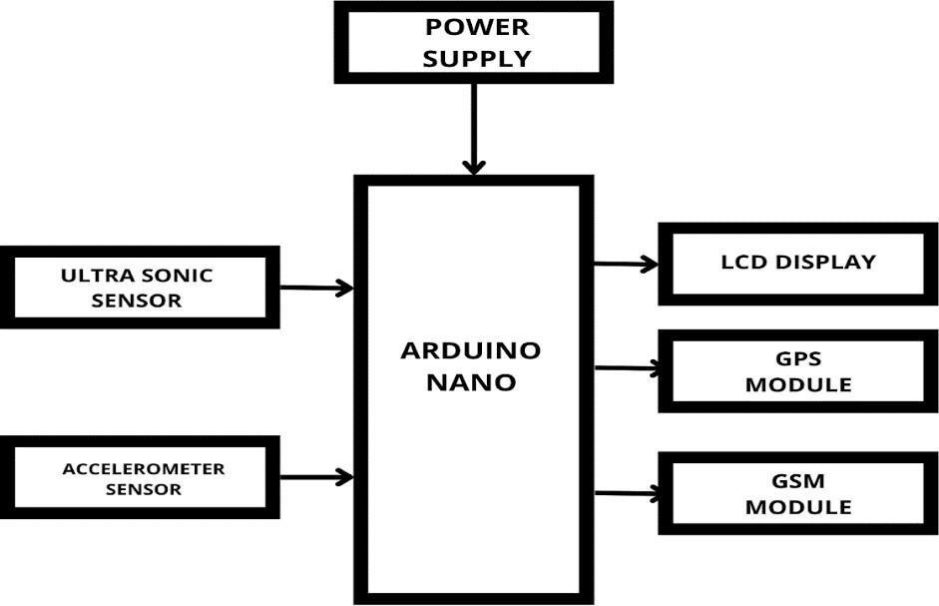
Block Diagram

Slide 7
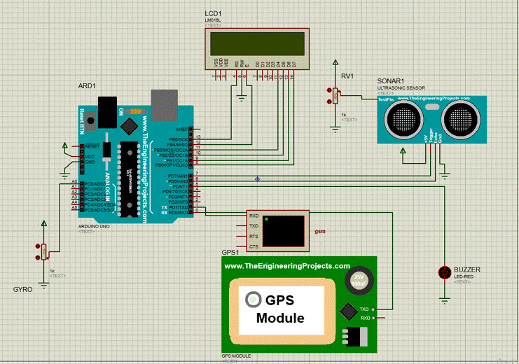
Circuit diagram

Slide 8
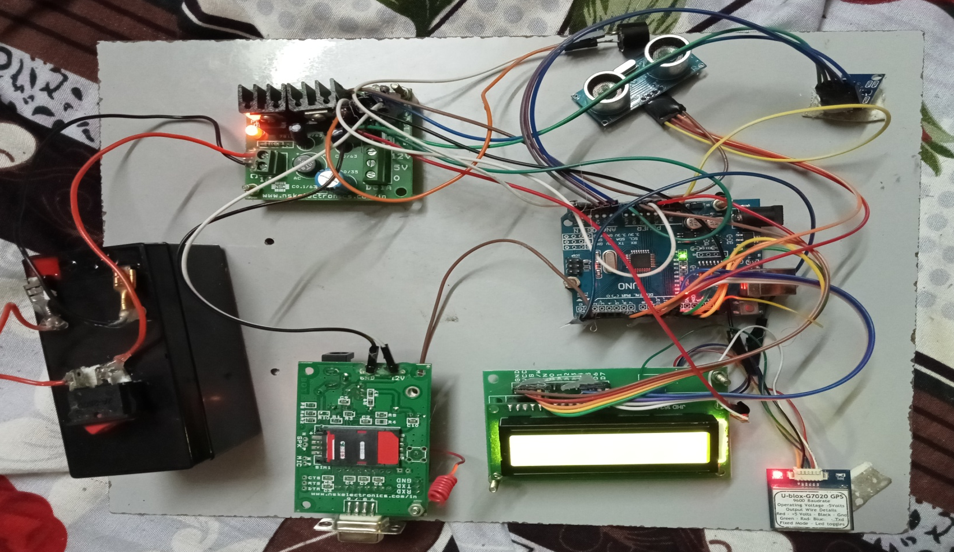
Hardware picture

Slide 9
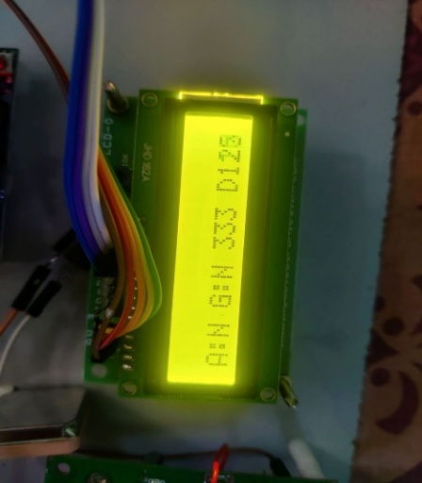
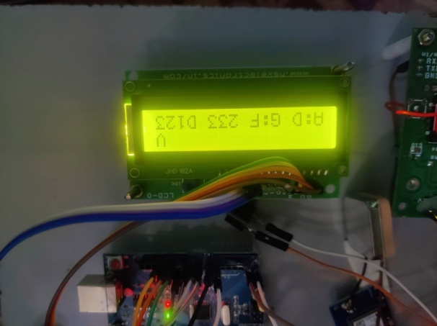
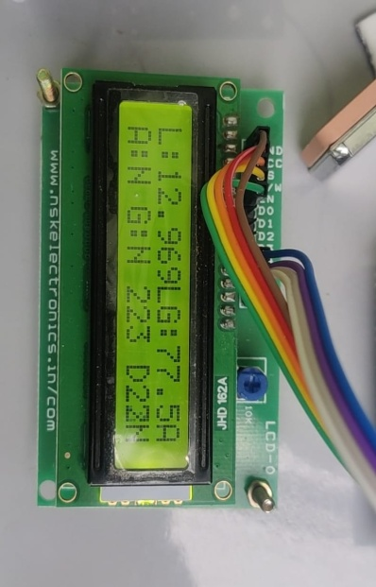
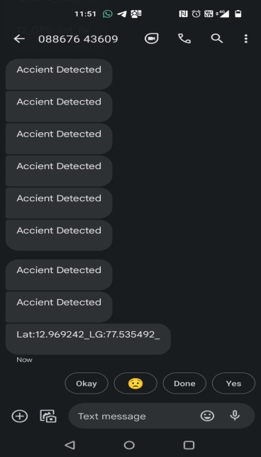

Slide 10
Components required
LCD DISPLAY
ARDUINO UNO R3
GSM MODULE
GPS MODULE
ACCELEROMETER
BATTERY- 12V
CONNECTING WIRES

Slide 11
Advantages
This system is an immediate aid system.
Monitors all hazards and threats.
Alert messages are sent to the nearby hospitals and police stations.
It is an affordable system.
Can be used in any kind of vehicle.
The alert message regarding the accident is automatically sent, This system can be used for a social cause.
It does not need any operation manually.

Slide 12
Limitations
Automatic or phone is disconnected or damaged.
Automatic and phone not connected via Bluetooth .
No GPS signal at the time of the crash .
Insufficient cellular signal to upload crash details.
The existing alert system projects include notification only to dear ones and the owner of the vehicle, but not to the emergency stations.
.

Slide 13
Applications
The main goal of the system is to alert the nearby medical services about the accident so as to provide immediate medical aid.
The application can make use of a sensor (accelerometer) in mobiles, to sense the tilt of the vehicle.
Thus, the system will make the decision to alert the admin (owner of the vehicle or family members) and it will send the information through the mobile app.
The system shall share the exact location of the accident with emergency medical services.

Slide 14
Future Scope
A more reliable system could be developed for remote areas.
GPS and Wi-Fi should be used together in such a manner that the nearby police station and hospitals are automatically
notified by the prototype itself so that faster medication can
be provided.
The system can also be interfaced with the air
bag system of the car to ensure security of the driver.
A camera module may also be interfaced to the device.

Slide 15
Conclusion
This system provides the optimum solution to poor emergency facilities provided to victims in road accidents in the most feasible way.
With the help of this technology immediate action can be taken when an accident occurs by alerting the respective people by sending a text or call.

Slide 16
REFERENCES
J. Whipple, W. Arensman and M.S Boler, “A Public Safety Application of GPS-Enabled Smart Phones And The Android Operating System”, IEEE International Conference on System, Man and Cybernetics, San Antonio, pp. 2059-2061, 2009.
M. Amin, M. Bin IbneReaz and S. Sheikh Nasir, "Integrated Vehicle Accident Detection and Location System", TELKOMNIKA (Telecommunication Computing Electronics and Control), Vol. 12, no. 1, pp. 73, 2014.
B. Prachi, D. Kasturi and C. Priyanka, "Intelligent Accident-Detection And Ambulance- Rescue System", International Journal Of Scientific & Technology Research, Vol. 3, No. 6, 2016.
9

Slide 17


